Slide 1
Faro Convention
The Value of Cultural Heritage for Society
Helmond in 100 stukskes

Slide 2
The Value of Cultural Heritage for Society
Council of Europe, 2005
Framework Convention:
issues at stake
general objectives
possible fields of intervention
Each country can define its own implementation and trajectory.
No obligations.

Slide 3
Faro principles
The need to put people and human values at the centre of an enlarged and cross-disciplinary concept of cultural heritage
The value and potential of cultural heritage as a resource for sustainable development and quality of life.
Every person has the right to engage with the cultural heritage of their choice.
The need to involve everyone in society in the process of defining and managing cultural heritage.
The principle of treating all cultural heritages equitably and so promote dialogue among cultures and religions

Slide 4
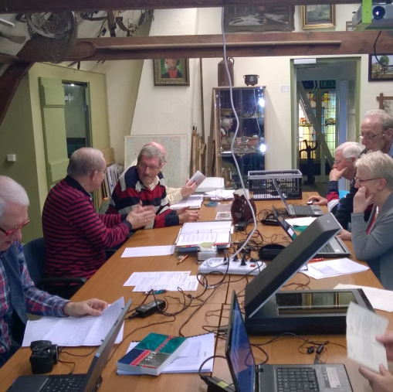
Heritage as a human right
Collectiebeheer Historische Vereniging Zwijndrecht
Everyone has the right to benefit from the cultural heritage and to contribute towards its enrichment
has the responsibility to respect the cultural heritage of others
Encourage:
people to participate in the process of identification, study, interpretation, protection, conservation and presentation of the cultural heritage
public reflection and debate on the opportunities and challenges which the cultural heritage represents
Rederij Lampedusa

Slide 5
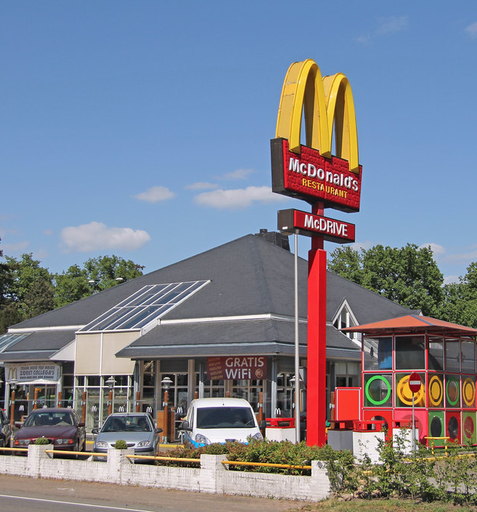
Mc Drive Huis ter Heide
Faro definition of cultural heritage
a group of resources inherited from the past
which people identify as a reflection and expression
of their constantly evolving values, beliefs, knowledge and traditions
independently of ownership
includes all aspects of the environment
resulting from the interaction between people and places through time.

Slide 6
Cultural heritage as a means for societal challenges
A resource
to facilitate peaceful co-existence
to enrich economic, political, social and cultural development and land-use planning
to reinforce social cohesion
by fostering a sense of shared responsibility towards the places in which people live;
Rederij Lampedusa

Slide 7
Faro as a game changer
Culturally sensitive approach
What are the social and cultural benefits?
Cultural Heritage should be exercised in daily life not only by experts also by individuals and heritage communities
Heritage as an asset for social cohesion, sense of place, in addition to having its own value.
Inter- and transdisciplinary approaches are needed to better understand and use culture to tackle societal and environmental challenges

Slide 8
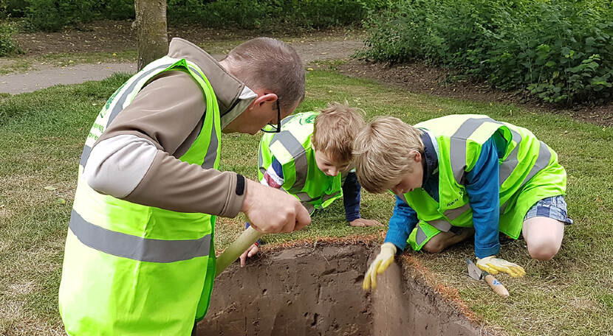
Participation as in
-> co-creation
-> partnership
-> citizen’s initiative
-> citizen’s control
Openness to other values
-> less institutionalized behaviour
-> incorporation of knowledge (know how) of citizens
-> incorporation of other perspectives
-> inter- and transdiciplinary cooperation
Linking heritage to societal goals
-> Wellfare
-> Social cohesion
-> Integration
-> Health
->…
Faro in the Netherlands
Community Archeology

Slide 9
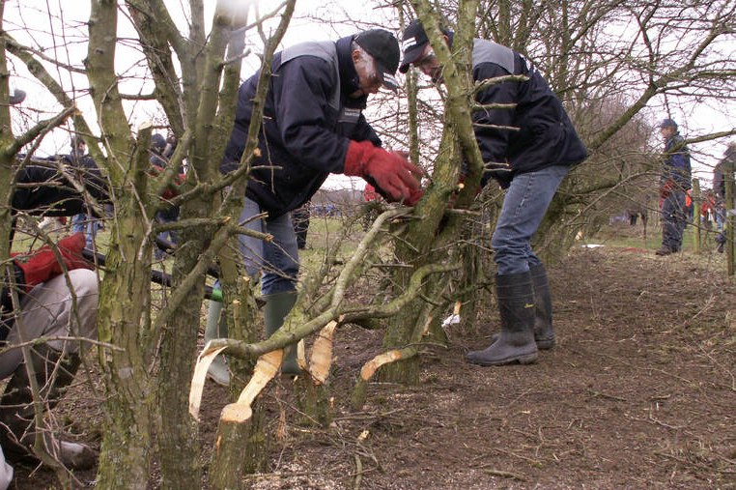
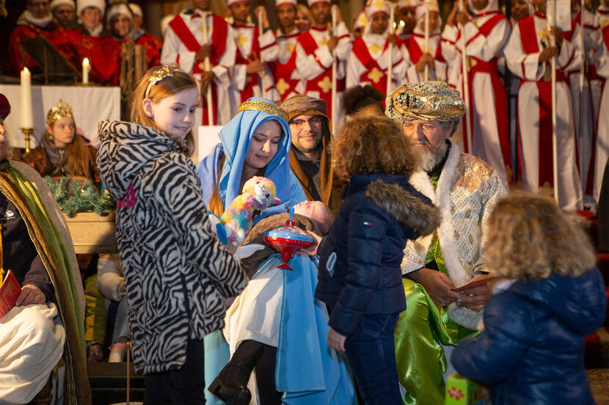
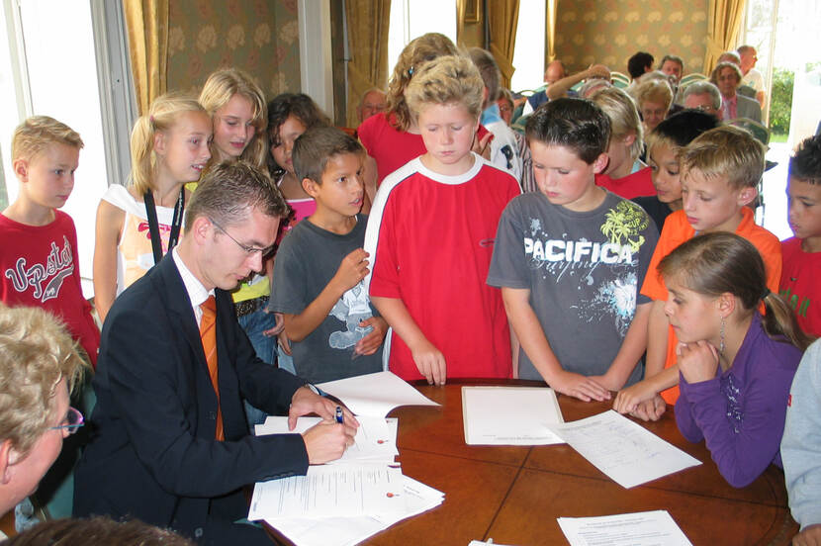
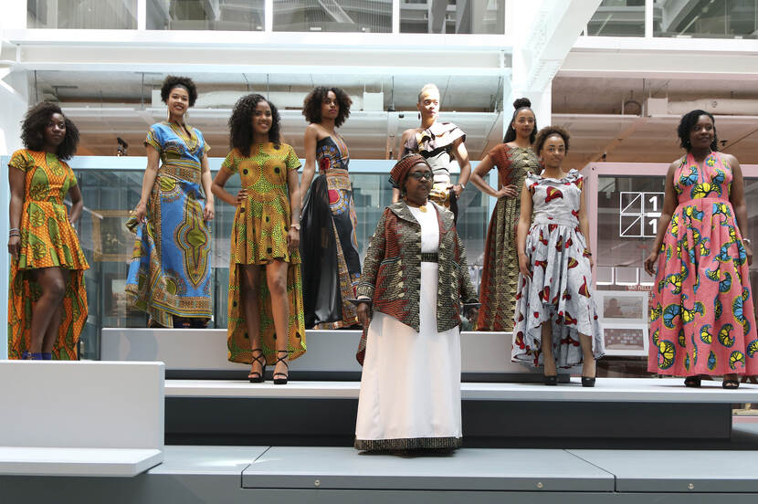
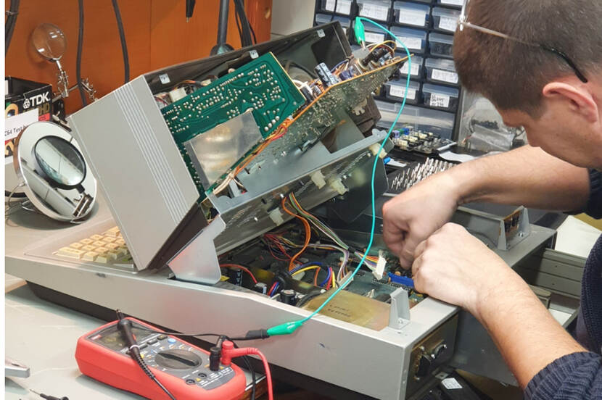
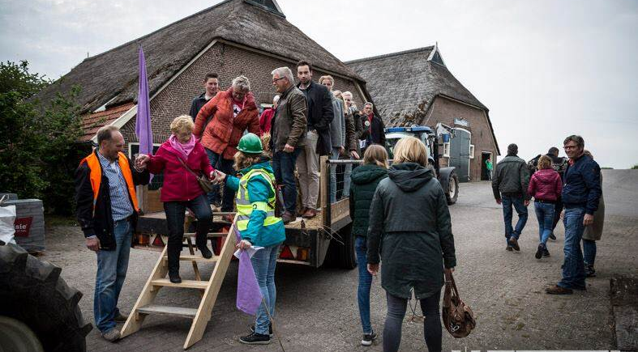
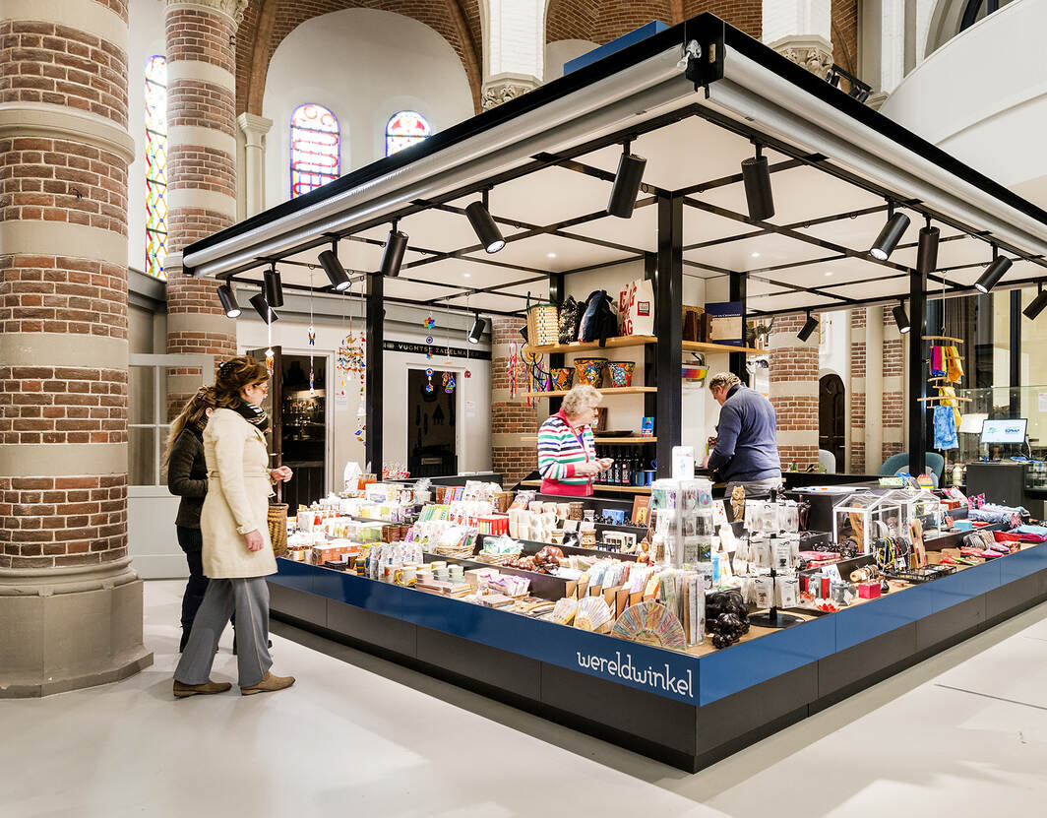
Faro Game Changer in process

